Slide 1

WHY

Slide 2
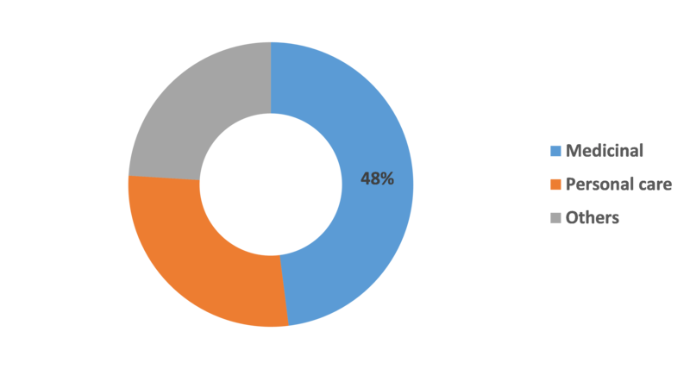




WHY
Usage Domains of Medicinal Plants in Nepal
Others
Frequent 1st choice in Far Western Nepal
(R. Kunwar et al.)
Medicine
25-50% Medicinal
$8.6-$27M worth of raw materials exported annually
Cosmetic
75%
In India
87%
In Nepal trusted and relied on Ayurveda during the covid pandemic
Medicinal plants, traditional medicine, markets and management in far-west Nepal

Slide 3

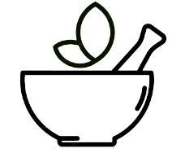



APPROACH
Accessibility
Growth
Authenticity
Informative

Slide 4
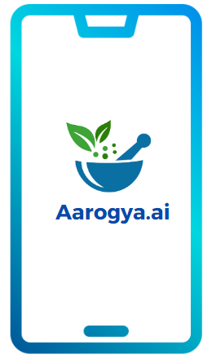
Aarogya.ai
An AI based approach that detects medicinal herbs and presents their usage, consumption and growth method
Khwopa Engineering College
Developed & Presented By
Jatin Bhusal
Prashamsa Bakhrel
Puskar Adhikari
Rohan Kaju

Slide 5




SYSTEM
Dataset
Augmentation
Model training
Via Camera/
Gallery
Preprocessing
Classification
Application
User
About
Usage
Growth

Slide 6
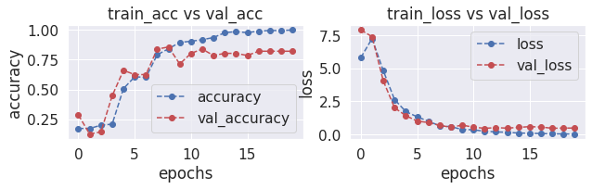
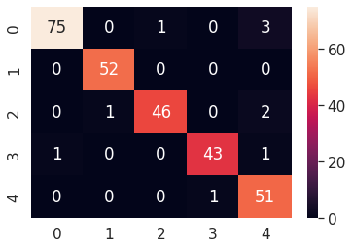
SYSTEM
Confusion Matrix
Accuracy & Loss Graph

Slide 7
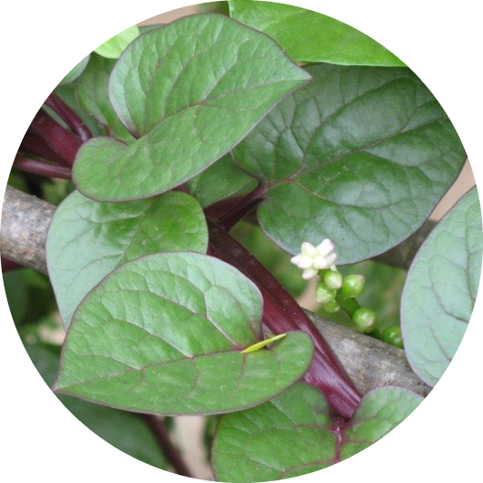
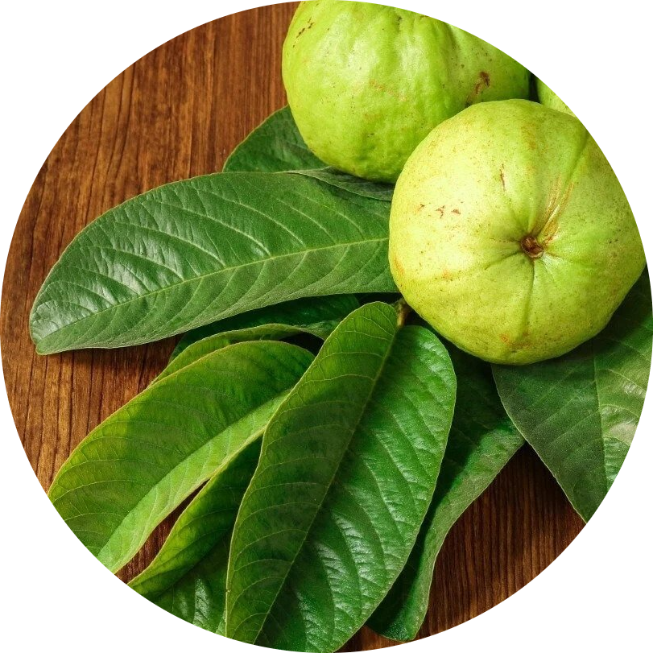
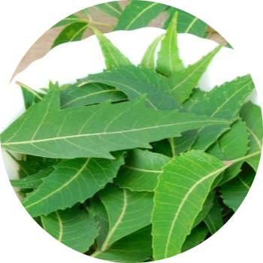
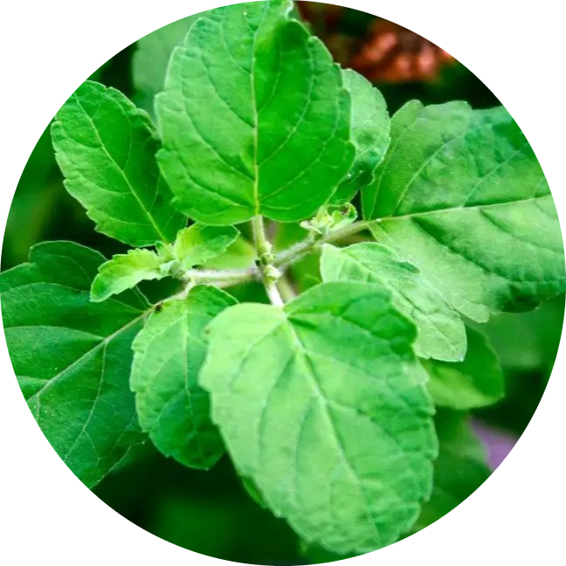
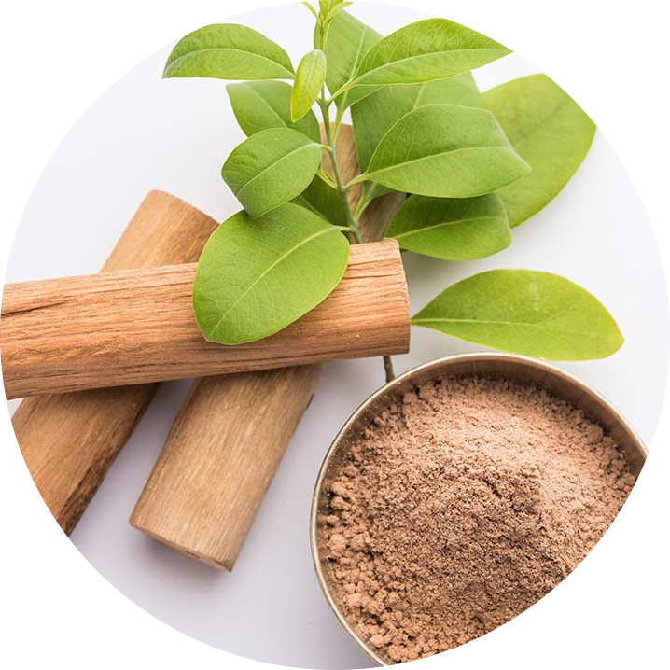
FEATURES
Neem
Guava
Basale
Gastritis
Intestinal issues
Skin Disease
Blood Pressure
Wounds
Burns
Tulsi
Sandalwood
Respiratory Problems
Fever and Cold
Urine Problems
Heart Diseases
Medicinal plants for women's healthcare in southeast Asia: A meta-analysis of their traditional use, chemical constituents, and pharmacology

Slide 8








SCALABILITY & BUSINESS MODEL
Future Enhancements
Home Usage
Track & Notify
Addition of new plants
Botanical Gardens
Researchers
Search
Hikers & Travellers

Slide 9
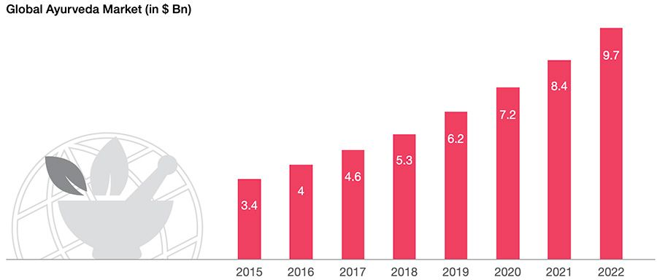
SCALABILITY & BUSINESS MODEL

Slide 10
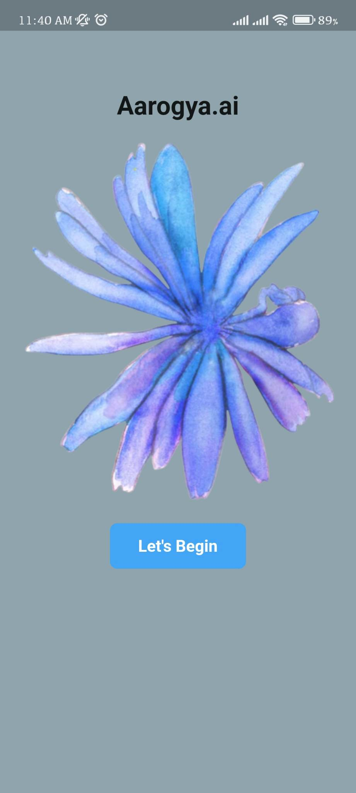

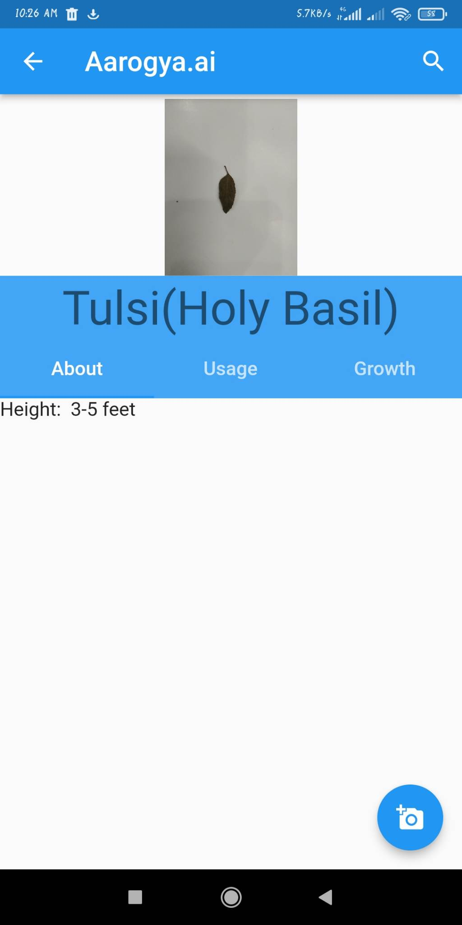
LAYOUT

Slide 11
CONCLUSION
Aarogya.ai
“Where tradition meets modern wellness.”

